Slide 1
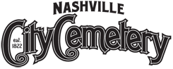
The City Cemetery is the oldest continuously operated public cemetery in Nashville.
Resting Place of ex President James K. Polk., four of Nashville's founders, James and Charlotte Robertson & John and Ann Robertson Cockrill; American Revolutionary War soldiers Lipscomb Norvell, Joel Lewis, Anthony Foster; four Confederate generals: Felix Zollicoffer, Bushrod Johnson, Richard Ewell, and Samuel Read Anderson; the man who named the American flag "Old Glory,“ and many more!
Home to families such as the Smiths, Browns, Johnson, Jones, Williams, Moores, Greens and with over 50 individuals buried with that name

Slide 3
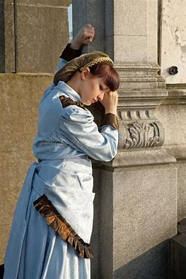
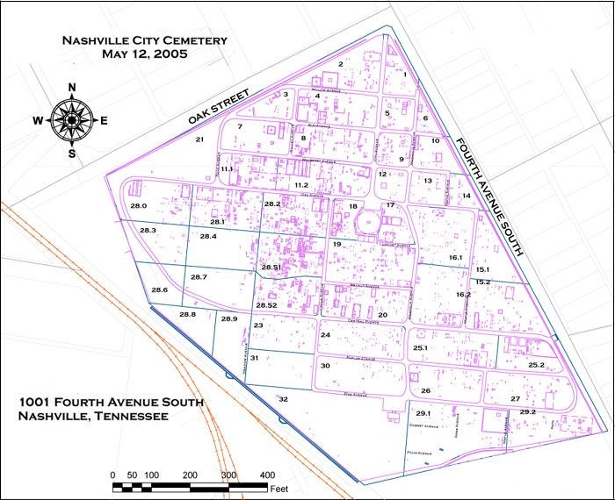
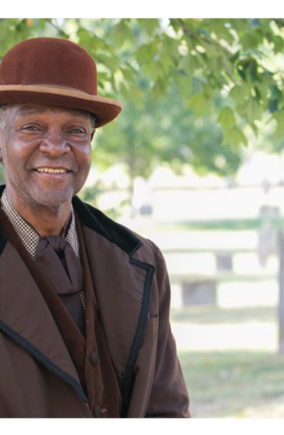
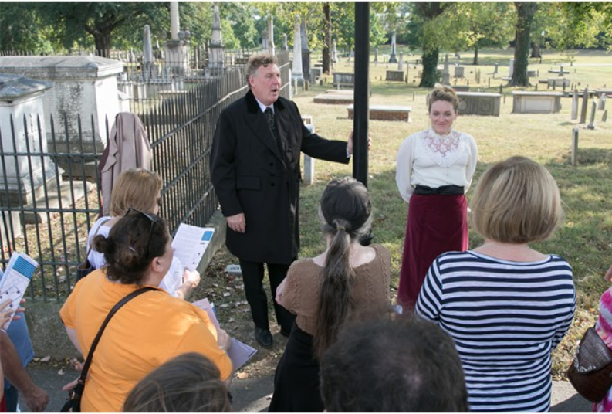
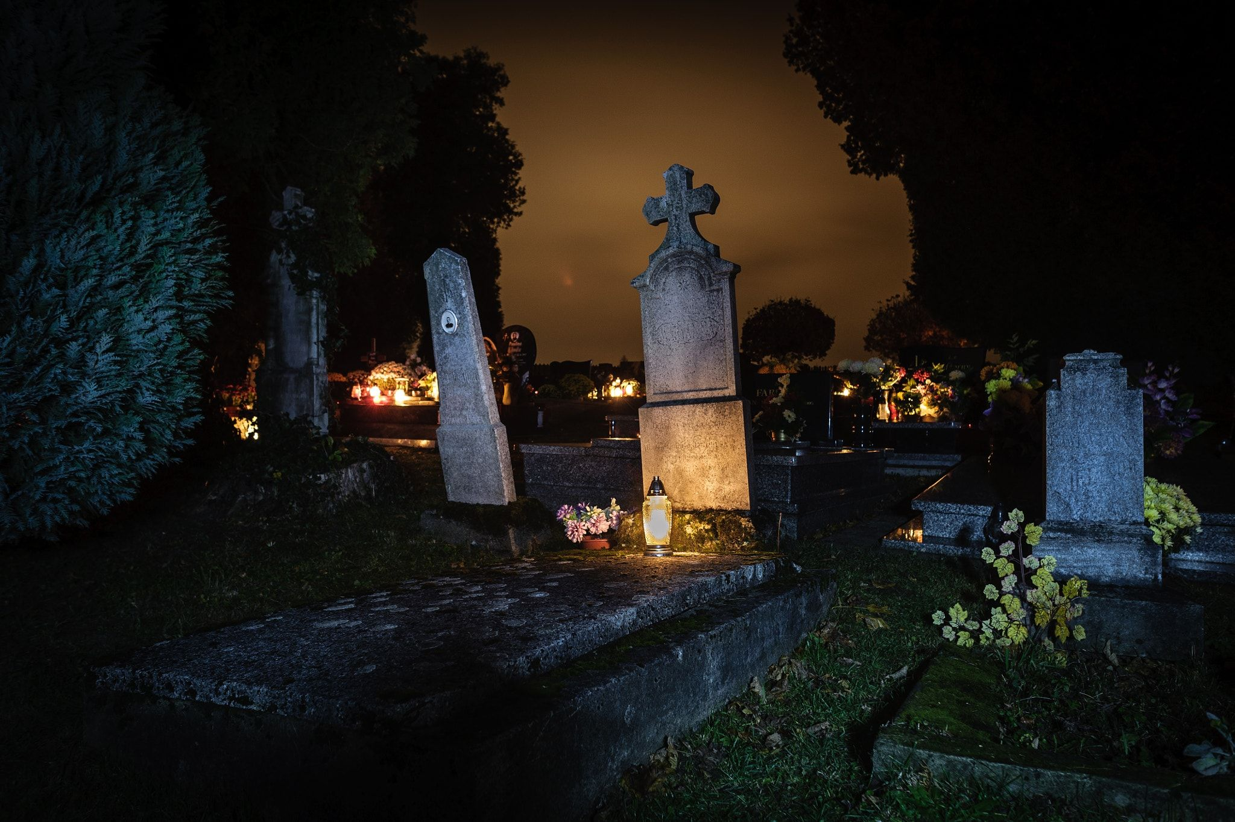



“I died of gunshot wounds from the Civil War but I was placed in a segregated Negro plot, separate from white soldiers.”
“I live in a plot with over 20 of my kin, the Smiths, though I was one of the youngest to die.. I was only 12”
“I died in 1857, of consumption.”
Visit
Explore
Learn
Halloween Spooktacular
Nightly Haunted Living Tour
Weekends in October
Hear stories from diverse backgrounds.
Listen to the stories of those old and young, as their spirits live on.
Learn about illnesses of the past: consumption, scarlet fever, summer complaint, cholera and more!

